Slide 1
PROPERTY
TAX APPROXIMATOR
- Sazna Gaffoor

Slide 2
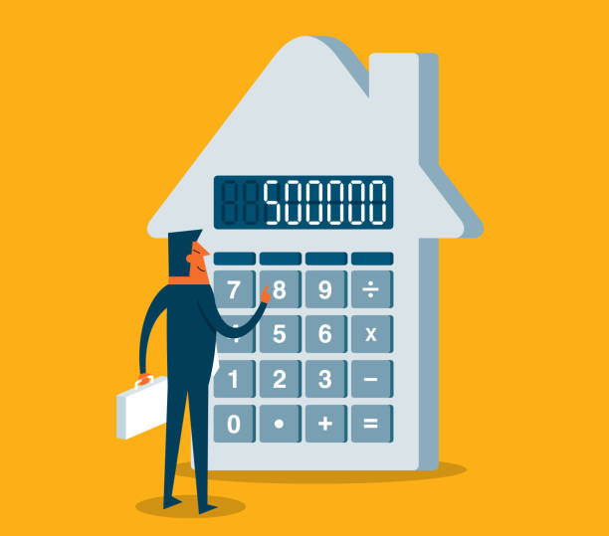
PROBLEM STATEMENT
Worried about how much tax to be paid for a new property?
Is the right amount of tax being paid?
Need an understanding of average property taxes in an area?
Need to know average property taxes on property type?
ONE SOLUTION TO
GIVE ANSWERS TO
ALL ABOVE?

Slide 3
SOLUTION
A system that predicts Property Tax rate
based on Location & Property Features
Not based on Property Price
Hassle-free prediction
Easy, effective and efficient

Slide 4
SYSTEM OVERVIEW
Raw House Price Dataset:
5000 records , 16 columns
Summary of Conducted EDA:
Completeness – Missing values were removed
Consistency – Cross-field / Range validations performed
Uniformity – Data standardized and Data Types Converted
Outlier Detection – Anomalies detected and removed
RESULTING DATASET → 4883 records → 97% of data preserved

Slide 5
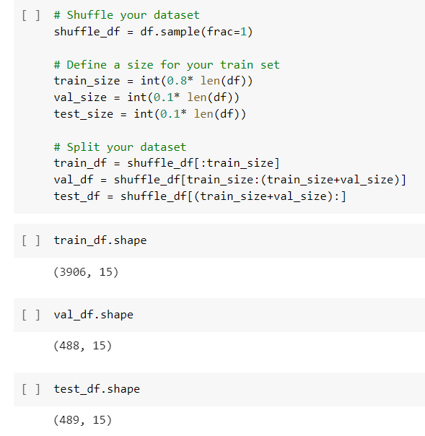
SYSTEM OVERVIEW
Dataset Splitting:
80% Training set
10% Validation set
10% Test set

Slide 6
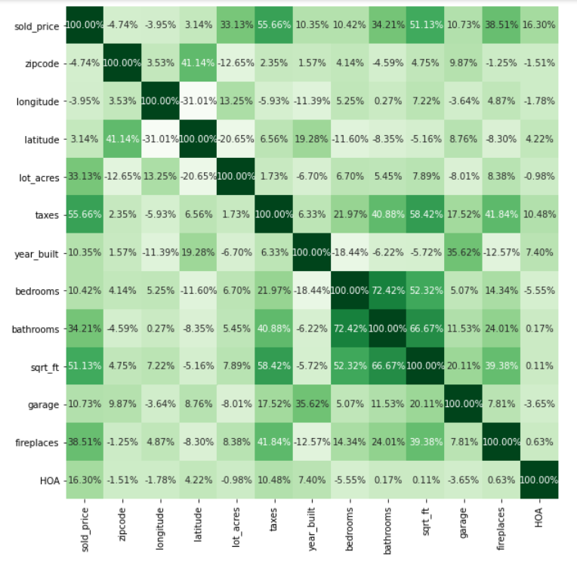
Correlation of Taxes with other Variables
Tax – Sqrt_ft
58.42%
Tax – Fireplaces
41.8%
Tax – Bathroom
40.8%

Slide 7
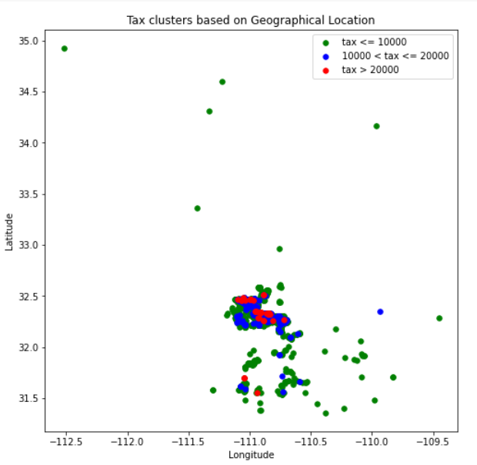
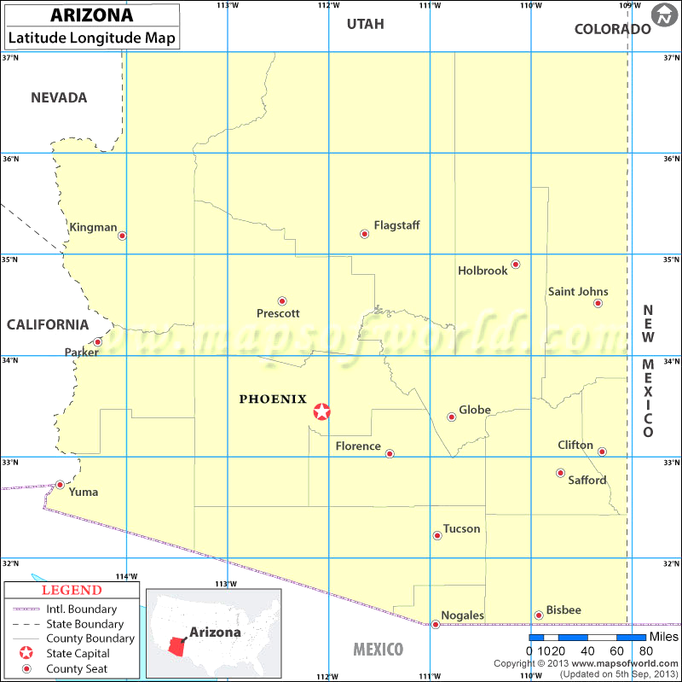
Correlation of Taxes with Longitude & Latitude

Slide 8
Procedure:
KNN CLASSIFIER
Longitude
Latitude
Tax
Sqrt_Ft
predicts
Tax / Sq_ft
LINEAR REGRESSION
Bin_Cat
Bathrooms
Fireplaces
predicts
Tax / Sq_ft

Slide 9
MODEL PERFORMANCE
MODEL | ACCURACY
KNN (k = 100) (epsilon = 1e-3) | 96.6%
MODEL | TRAIN | VALIDATION | TEST
LINEAR REGRESSION | 0.73 | 0.60 | 0.70

Slide 10
SUMMARY
Tax amount could be efficiently calculated using the KNN Classifier Model and Linear Regression Model.
~ The KNN (k=100) model has an accuracy of 96.6%
~ Logistic Regression has a R² value of 0.70
Tax amount can be predicted using:
Location (Latitude & Longitude)
Square feet
Number of Bathrooms
Number of Fireplaces

Slide 11
QUESTIONS
& FEEDBACK

Slide 12
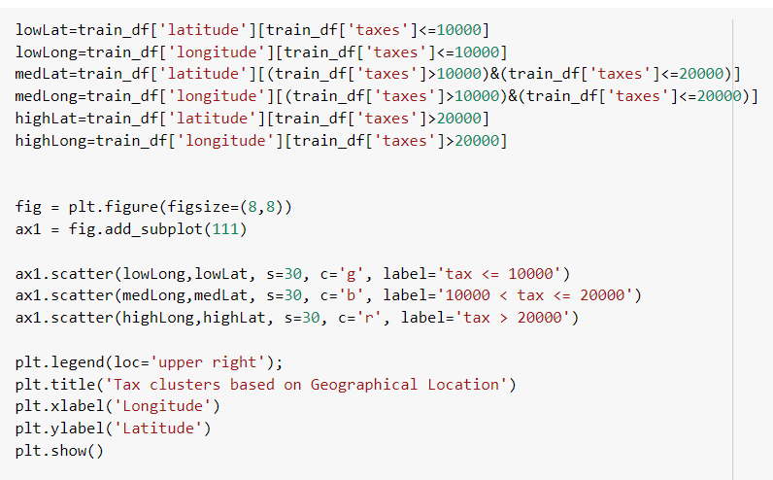
APPENDIX 1
Categorization of
Tax for lat. & long.

Slide 13
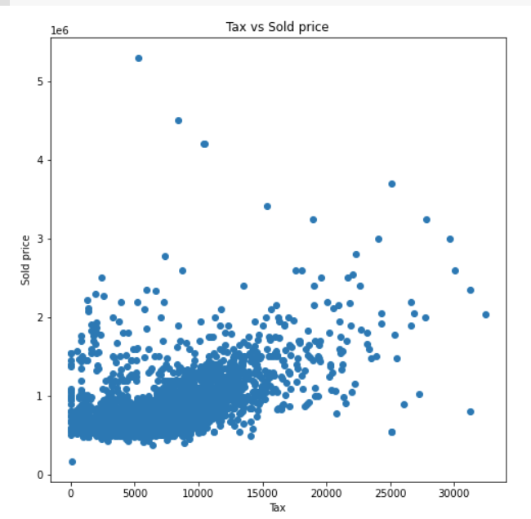
APPENDIX 2
Tax distribution

Slide 14
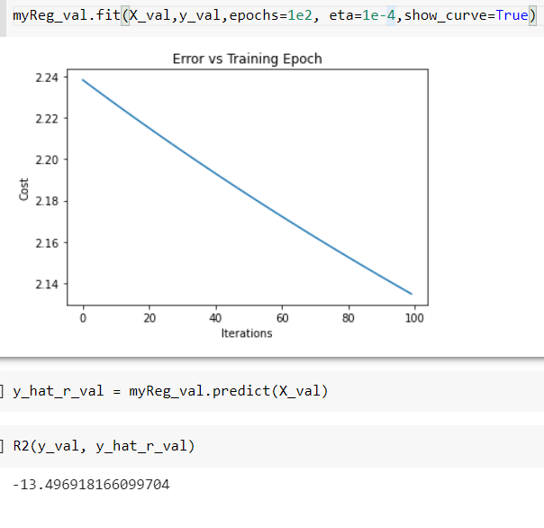
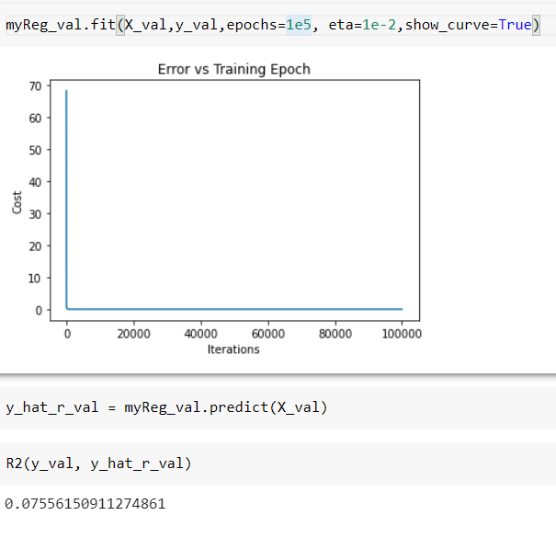
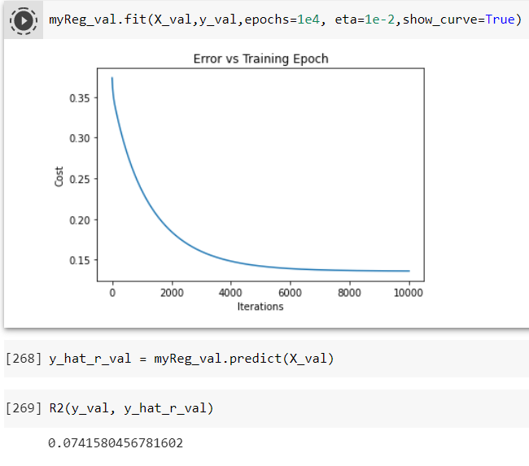
APPENDIX 3
Linear Regression Fine Tuning
Epoch – 1e2
Eta – 1e-4
Epoch – 1e5
Eta – 1e-2
Epoch – 1e4
Eta – 1e-2

Slide 15
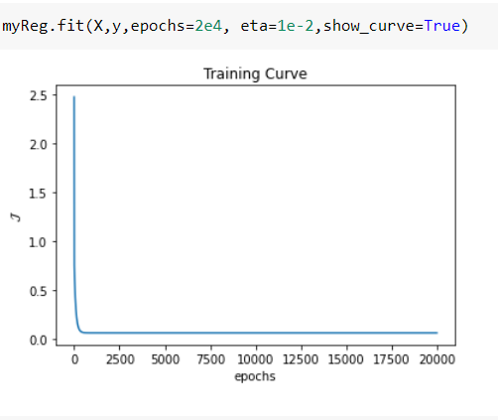
APPENDIX 4
Error vs Training Epoch

